Slide 1

Manawa Community Meeting held on Monday, July 15, 2024
Topic: Flash Flood of July 5, 2024

Slide 2
Organizations presenting
-City of Manawa officials
-Waupaca County Emergency Management
-State Emergency Management
-Waupaca County Health Department
-Cedar Corporation (City’s civil engineers)
-Community Development Block Grant Program (CDBG)
Central Housing Region
-American Red Cross
Counseling available after this presentation in the HS Office
-Waupaca County ADRC & Mental Health

Slide 3
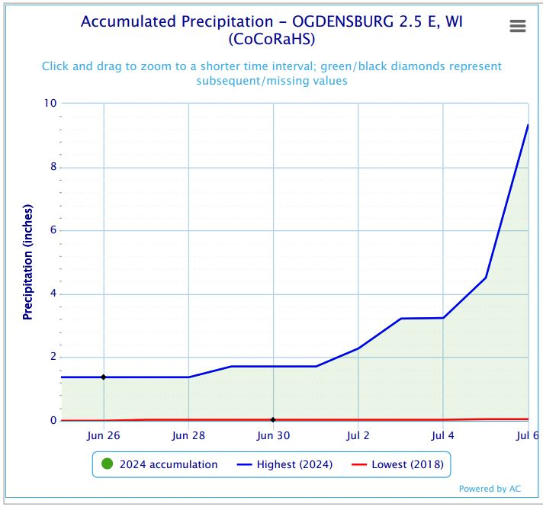
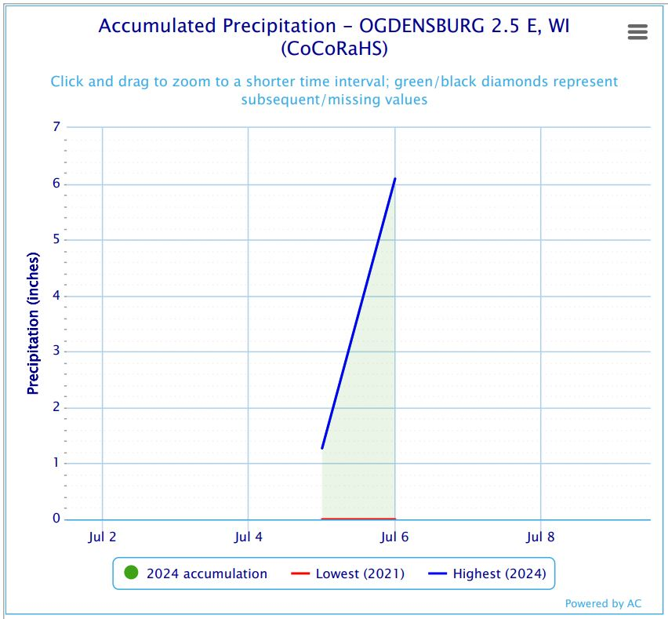
National Weather Service Information
NWS reports 5.69” between 8:30 am & 11:00 am
Most of the rain came in approx. 45 minutes to an hour

Slide 4
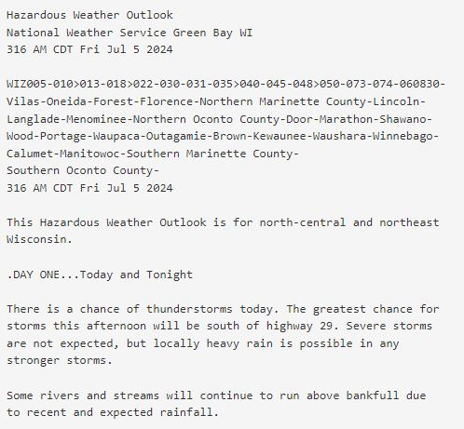
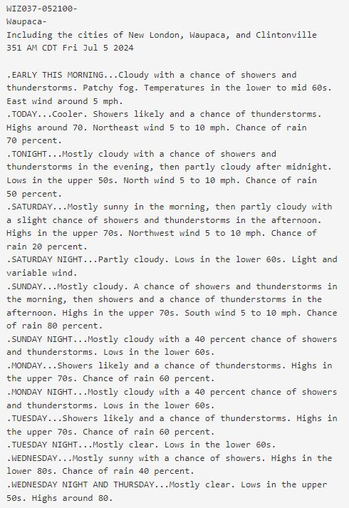

Slide 5
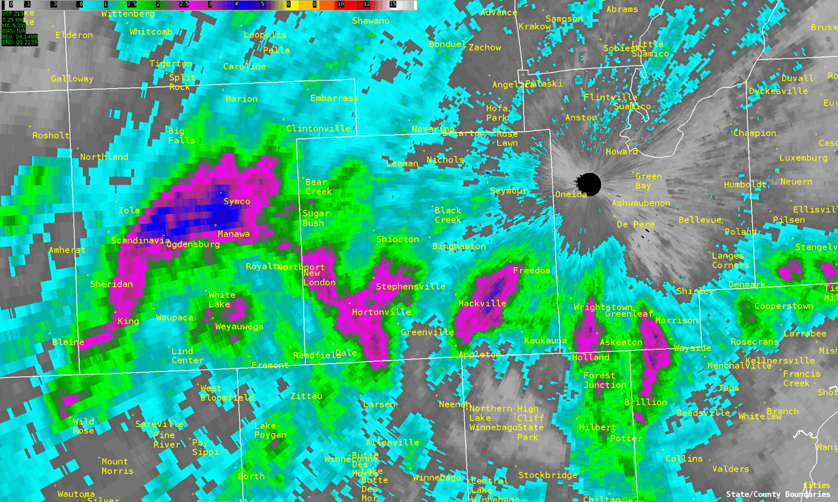

Slide 6
Brief timeline of events
-6:48 am Dam operator did daily checks. Forecast was for 1.24” of rain, so dam gates were opened to the appropriate level
-7:08 am Rain began falling
-9:48 am Water begins to flow north past storm sewer grate at Bridge/ Union
-9:49 am Water begins to flow down the driveway into Lindsay Park
-9:56 am Water is nearing the center line of Bridge and the storm sewer is half covered with flowing water
-10:00 am The storm sewer is mostly unable to take in anymore water
-10:19 am Entrance from Bridge into Lindsay Park appears flooded. Water flowing into the park.
-10:20 am Most of the green space in Lindsay Park from the upper restrooms to the baseball diamond is flooded with a current flowing.

Slide 7
-10:25 am The green space is flooded between the pavilion and the tennis court
-10:26 am Report of a stranded motorist on the north end of Bridge St. water rescue needed. Fire engine and MRAP needed, as passenger vehicles cannot pass.
-10:26 am Wastewater Treatment Plant floods, but maintains contents
-10:29 am Dam operator received a notification the water level was high
-10:40 am Officers notice E. Howard and Industrial have high standing water
-10:45 am Rain begins to slow
-10:50 am Bridge/ Union camera shows water beginning to recede
-10:50 am Deputy arrives at the Fire Department to set up Incident Command
-10:52 am Waupaca Co. Highway Department requested to barricade high water areas
-10:55 am Waupaca Co. Emergency Management arrives to the Command Post
-10:57 am Department of Public Work’s Nick Weed arrived at the high school to open the building as a shelter
-10:57 am Emergency vehicle is seen on the H.S. camera on-scene at the nursing home
-11:00 am Rain mostly stopped and water receded back to the parking lane Bridge/ Union

Slide 8
-11:00 am Dam operator arrived and saw water was going over the dam and embankment
-11:01 am The first mutual aid fire department arrives
-11:04 am Manawa PD phones Jacob Elsner of Kobussen bus
-11:05 am First call for evacuation of residents from the trailer park on Walnut St
-11:15 am Dam operator meets fire chief at Incident Command and briefs him
-11:20 am Second bus called for nursing home evacuation
-11:22 am Minimal water on the road and draining into storm sewer Bridge/ Union
-11:27 am Bogs seen flowing from the north to the south on the Mill Pond
-11:30 am Water begins receding in the green space between pavilion and tennis court
-11:33 am Police Chief phoned the mayor and Mayor Frazier declared the flash flooding an emergency to Andrew Carlin Director of Waupaca Co. Emergency Management

Slide 9
-11:36 am City of Waupaca employee arrives to assist at the wastewater treatment plant
-11:44 am Manawa Officer Wesoloski arrives at the high school evacuation site
-11:53 am Video is taken and sent to the Command Post of water going over the dam railing on the west side by the embankment and over the walkway by the dam building to the south
-11:56 am Power company arrives to cut power to the park to avoid injuries
-12:06 pm Cameras in the lower park stop
-12:15 pm First bus seen arriving at the nursing home, via the H.S. camera
-12:17 pm Bridge is closed to non-emergency traffic
-12:21 pm Third bus called for rodeo grounds and trailer park evacuation
-12:45 pm Water had receded on the dam enough to attempt to open the gates and remove the boards.
-1:08 pm North embankment failure worsens
-1:13 pm Water can be seen traveling from the river into right field at the baseball field

Slide 10
-1:35 pm The softball, baseball fields, buildings, wastewater treatment plant are all flooded along with the City shop’s parking area
-2:15 pm Evacuation started at the nursing home
-3:01 pm A small and large bus were seen leaving the nursing home from the H.S. camera
-4:40 pm The water begins to recede by the City’s lower shop
-4:45 pm Nursing home residents arrive at King Veterans Home
-5:00 pm Evacuated residents allowed to go back home
-5:30 pm All mutual-aid departments were released
-5:45 pm High School evacuation site closed and Kobussen provided a ride home to a resident
-6:00 pm The water has mostly receded to the upper restrooms

Slide 11
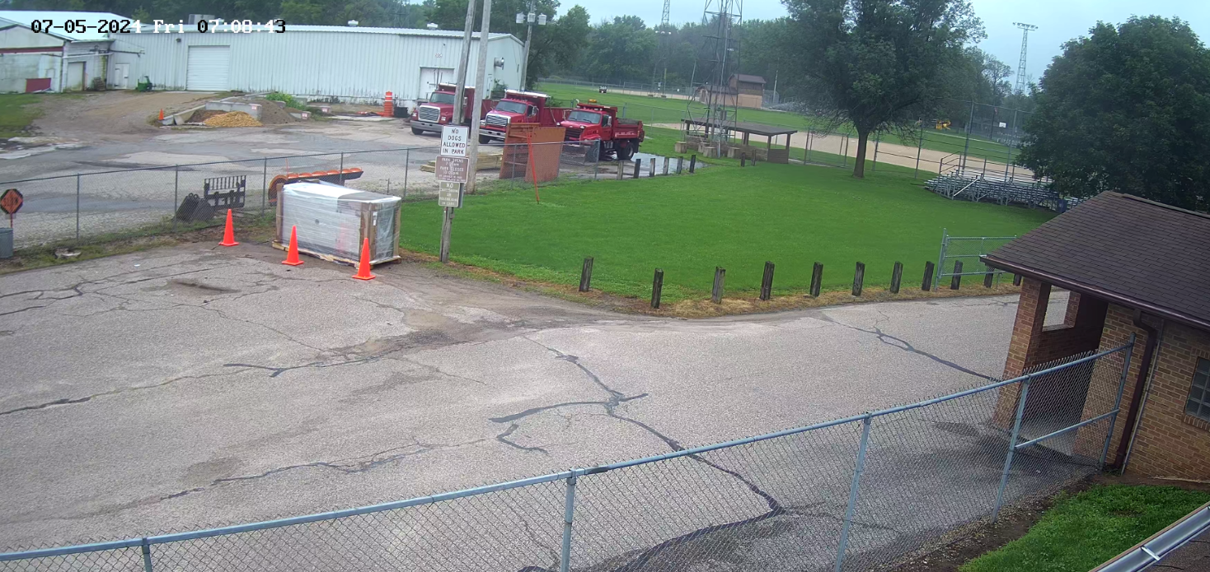

Slide 12
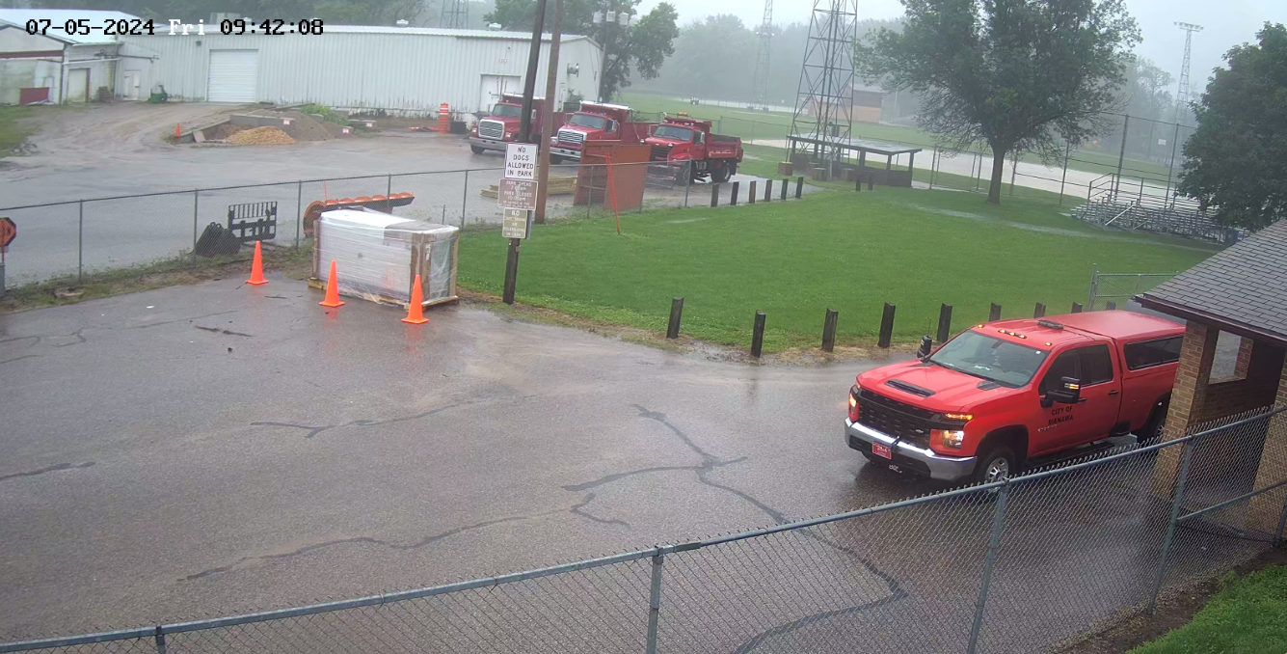

Slide 13
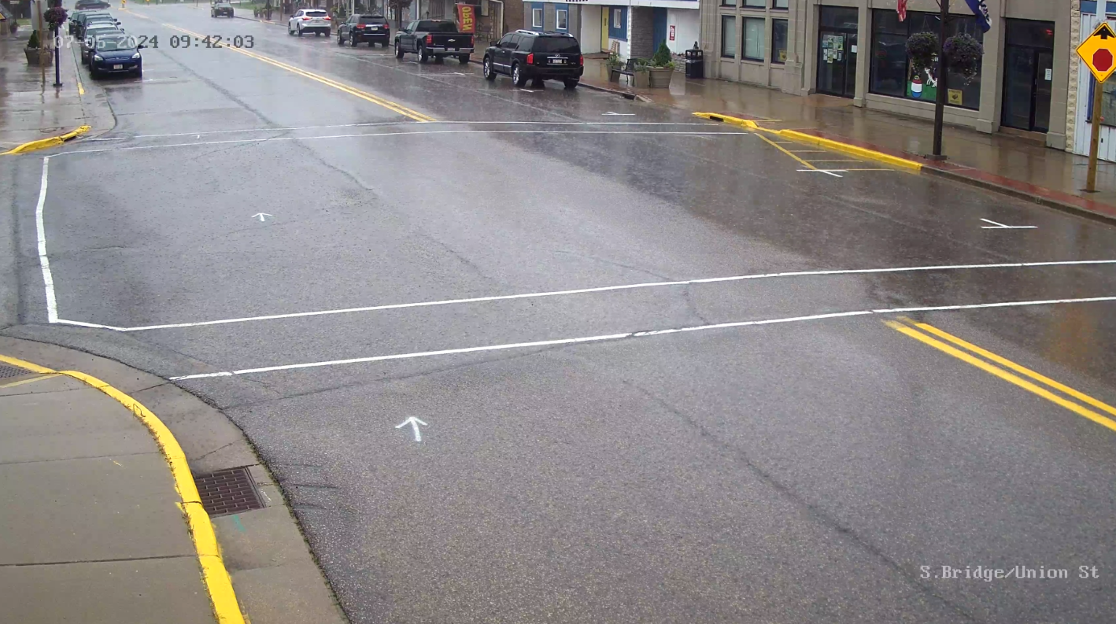

Slide 14
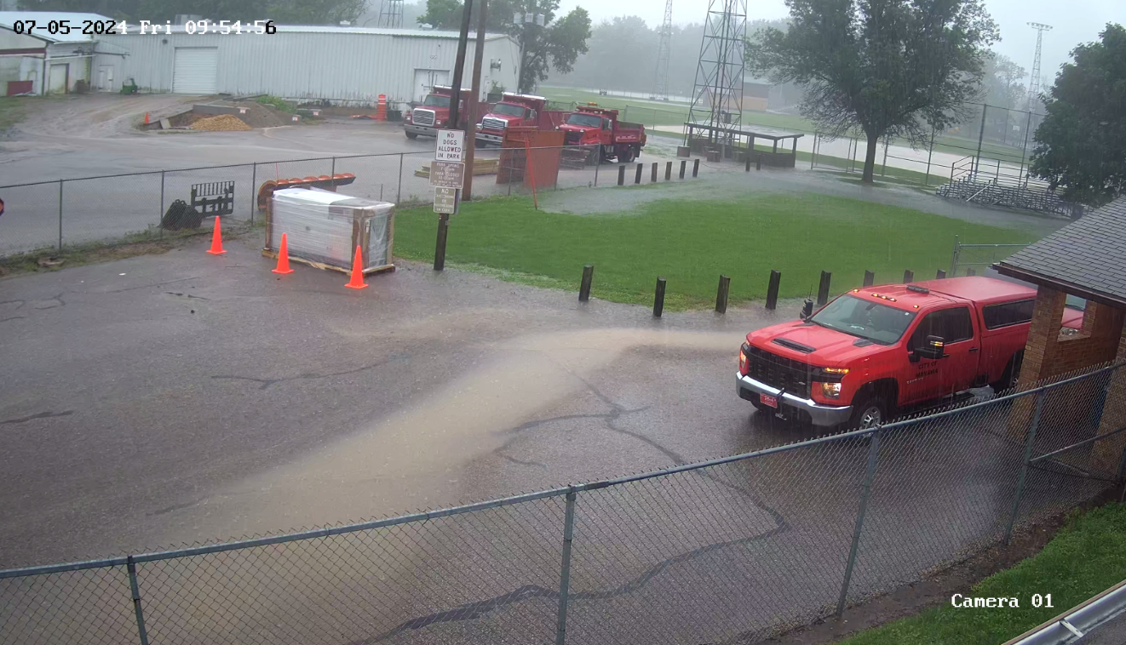

Slide 15
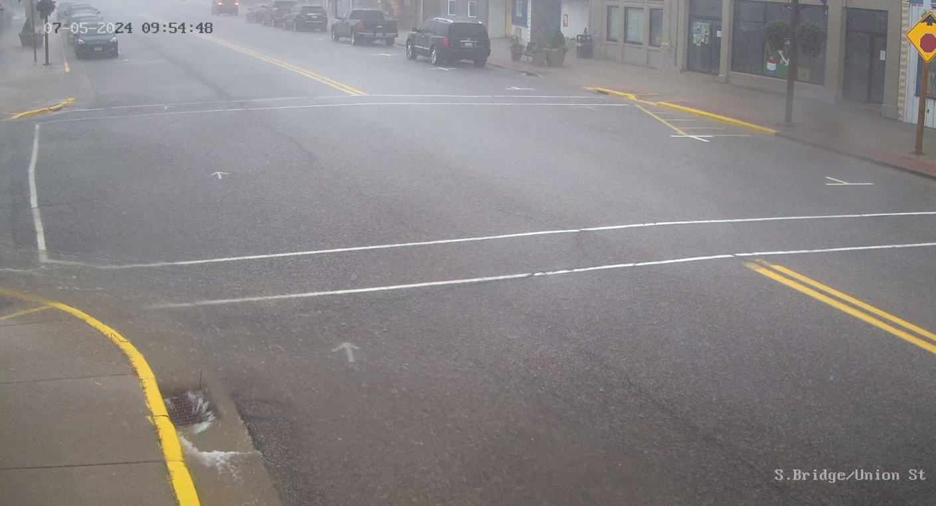

Slide 16
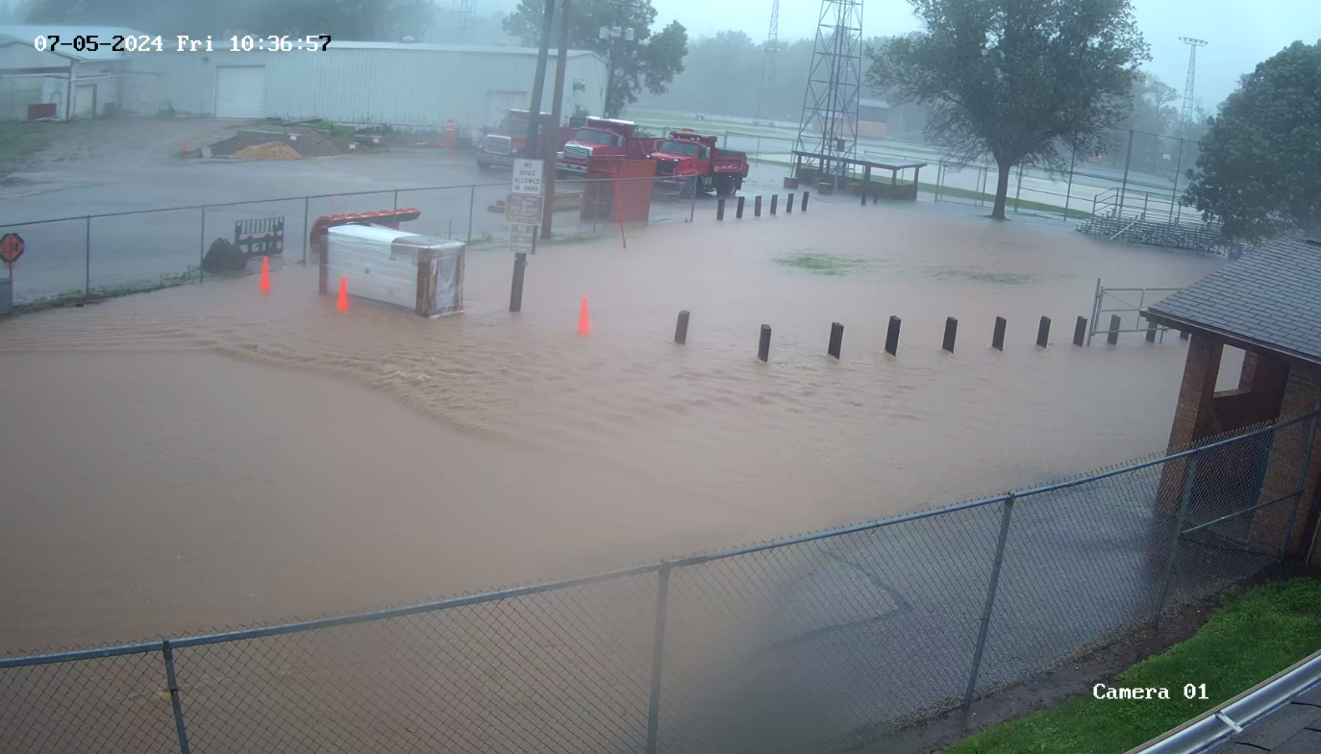

Slide 17
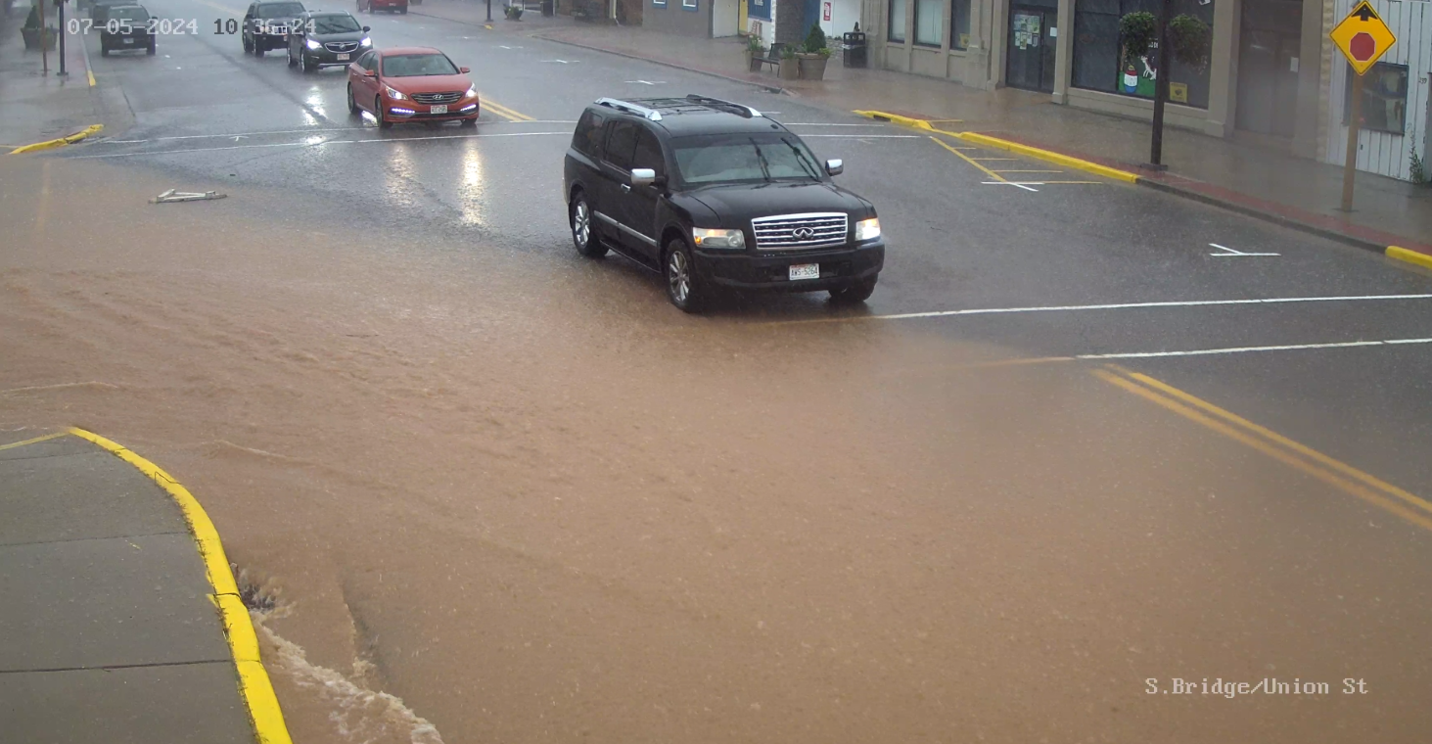

Slide 18
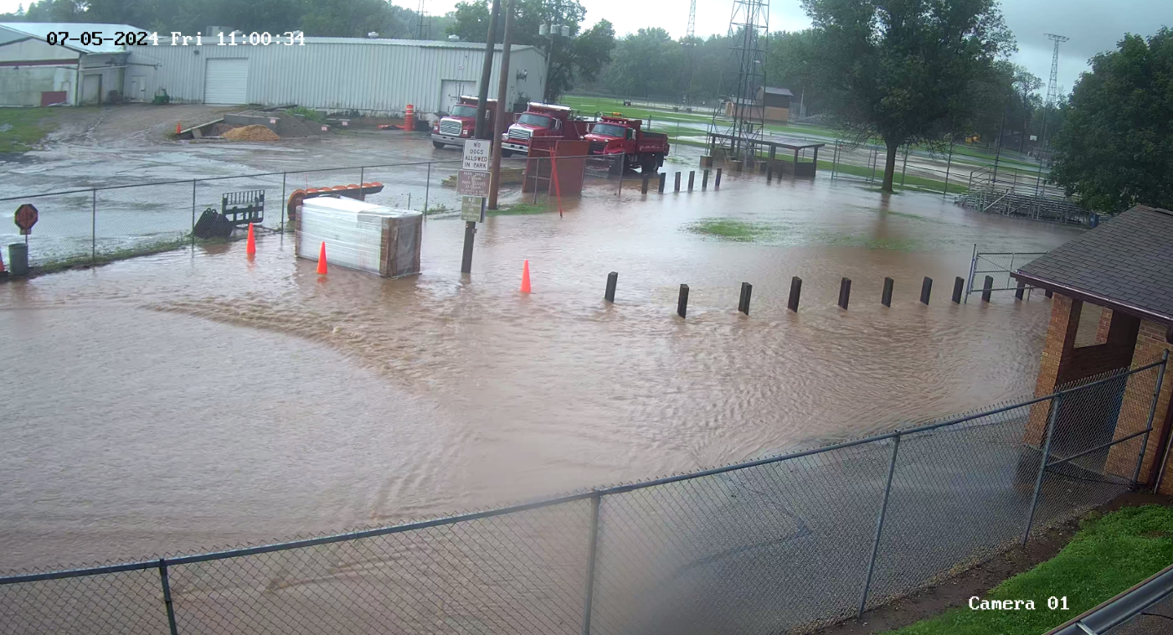

Slide 19
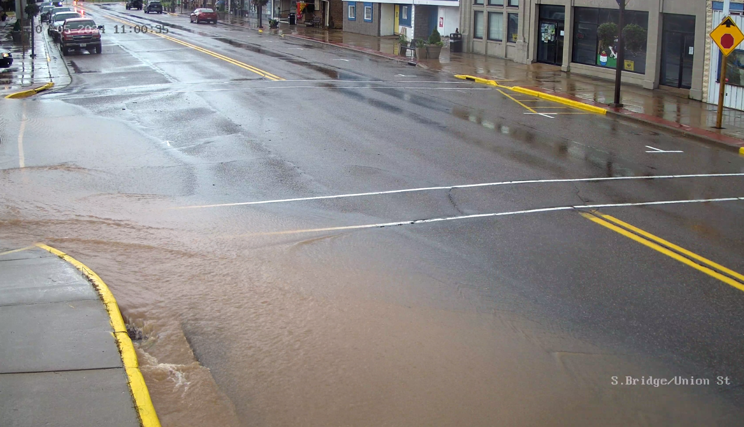

Slide 20
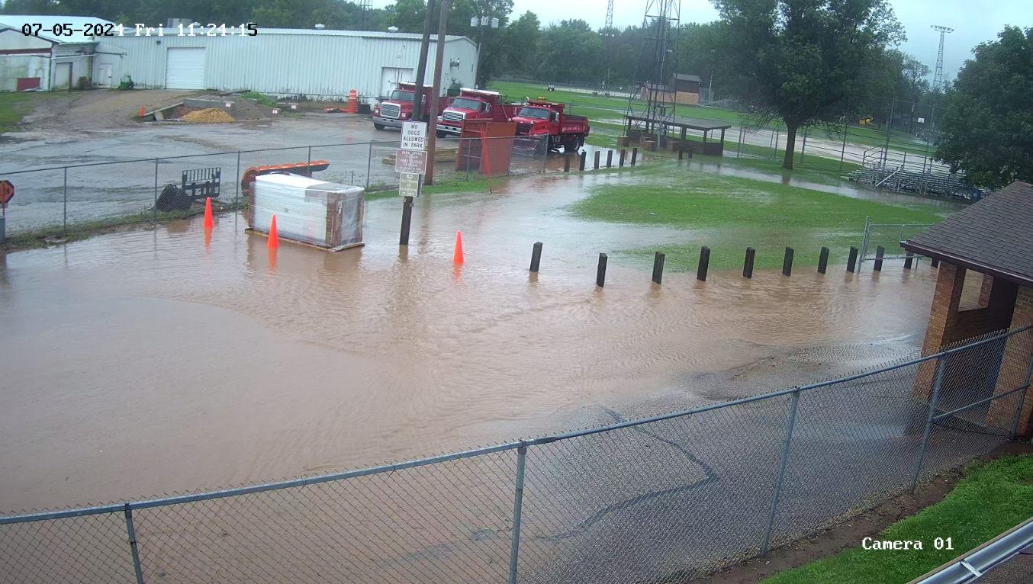

Slide 21
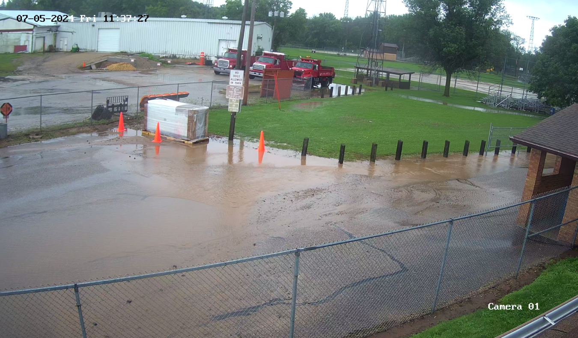

Slide 22
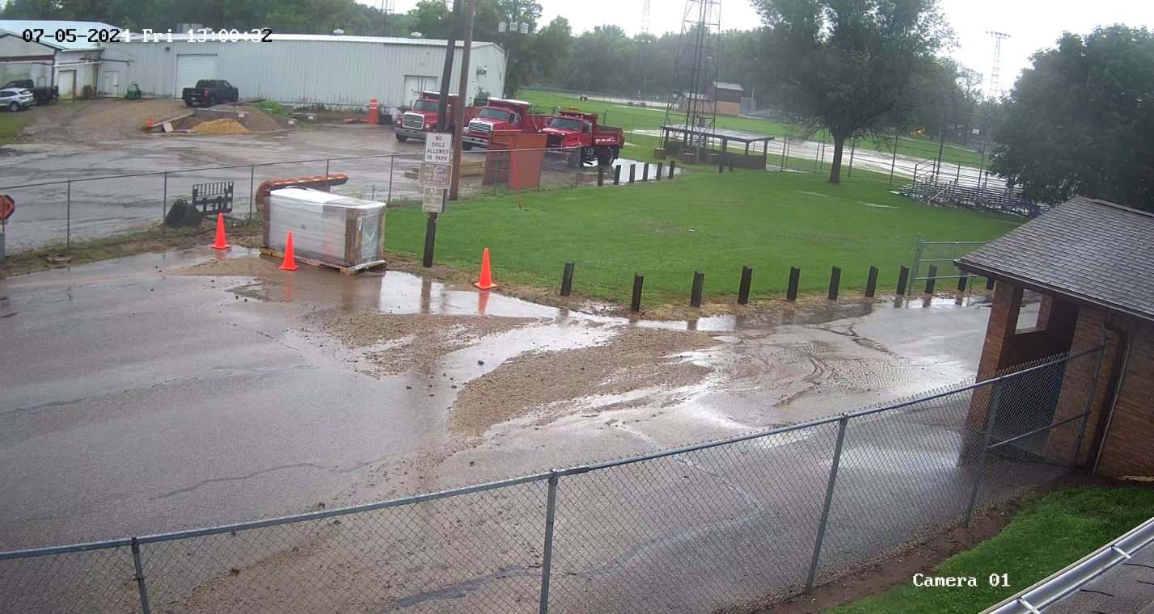

Slide 23
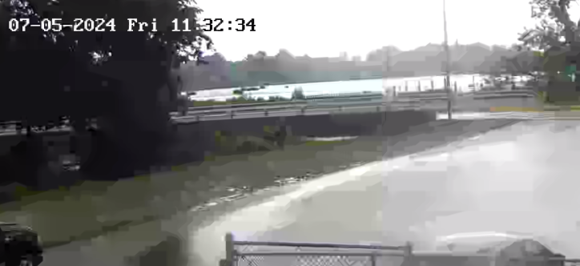

Slide 24
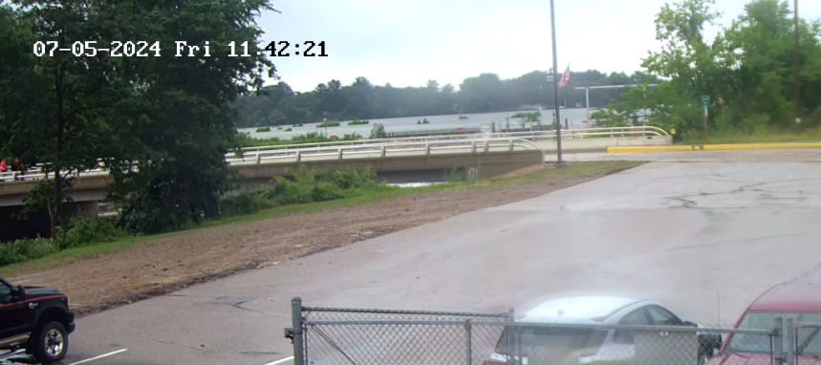

Slide 25
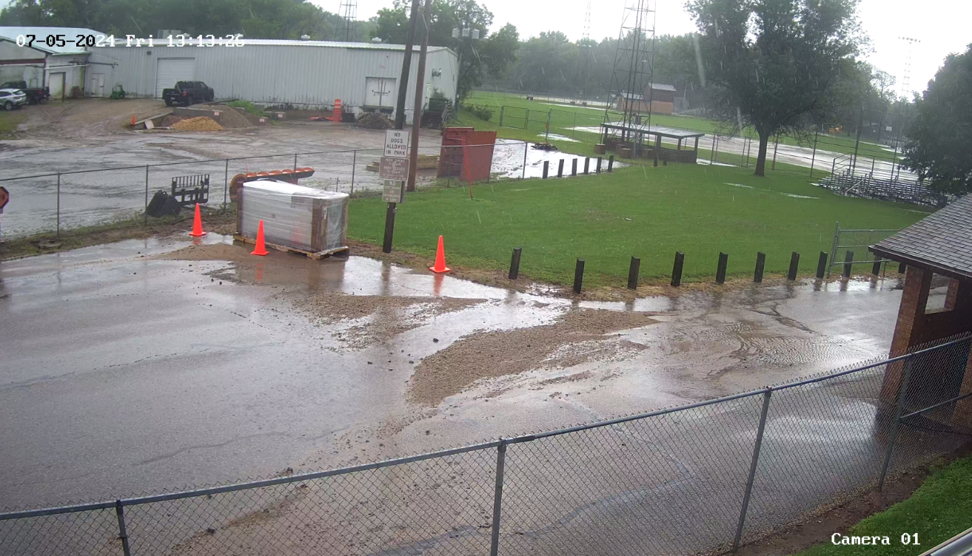

Slide 26
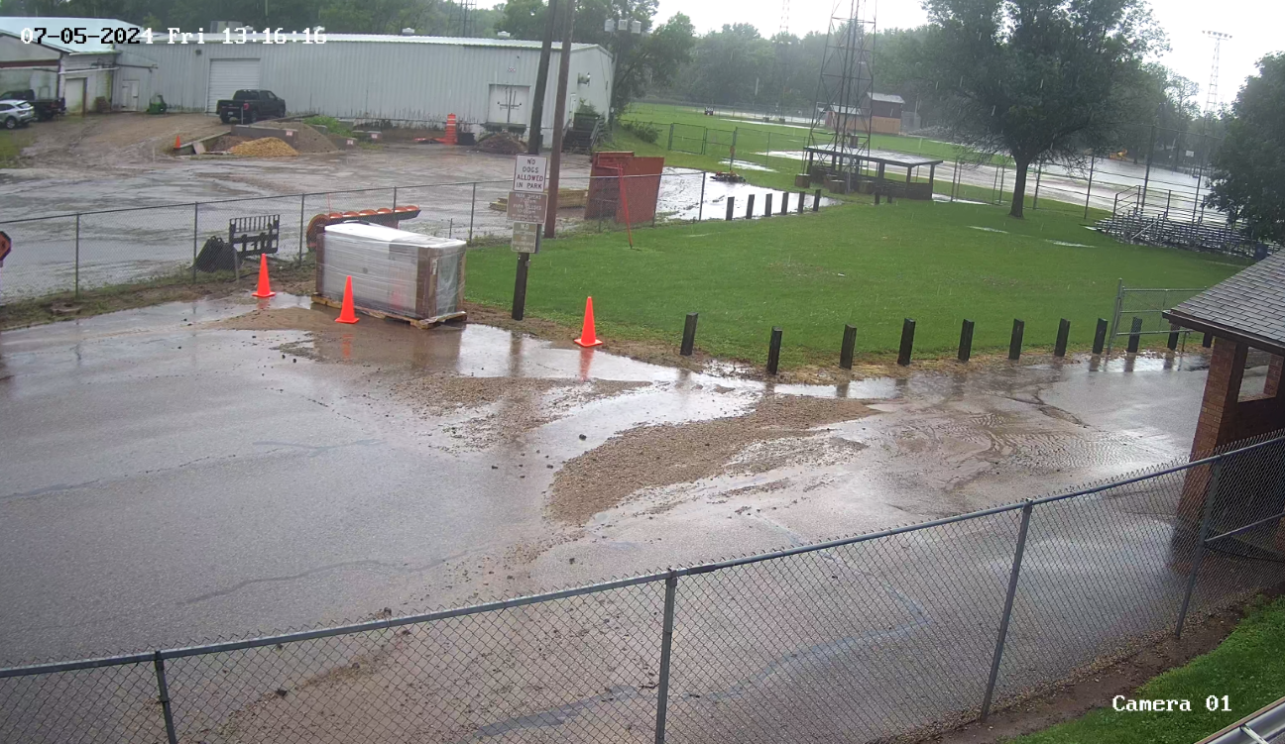

Slide 27
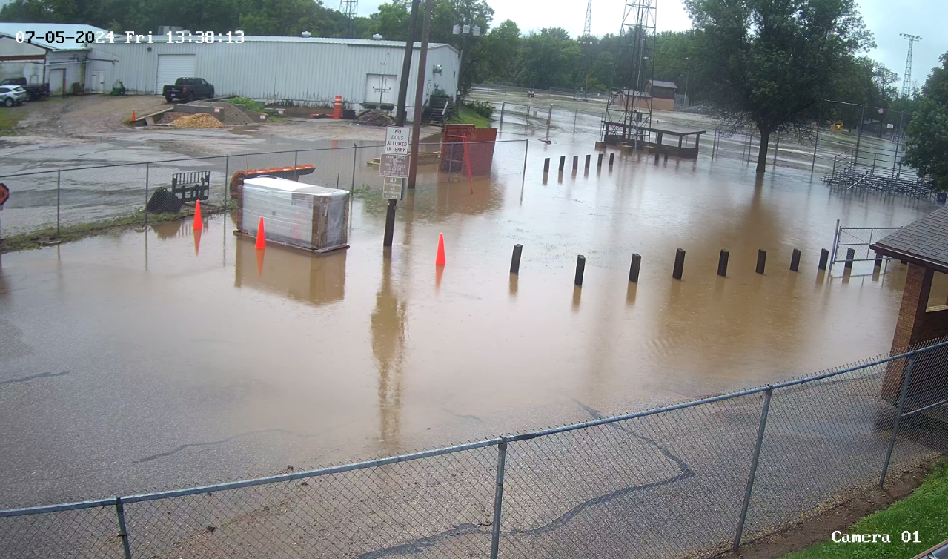

Slide 28
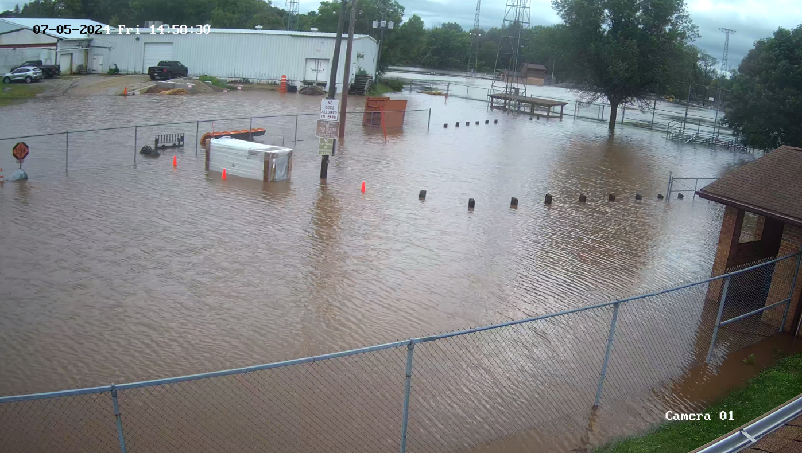

Slide 29
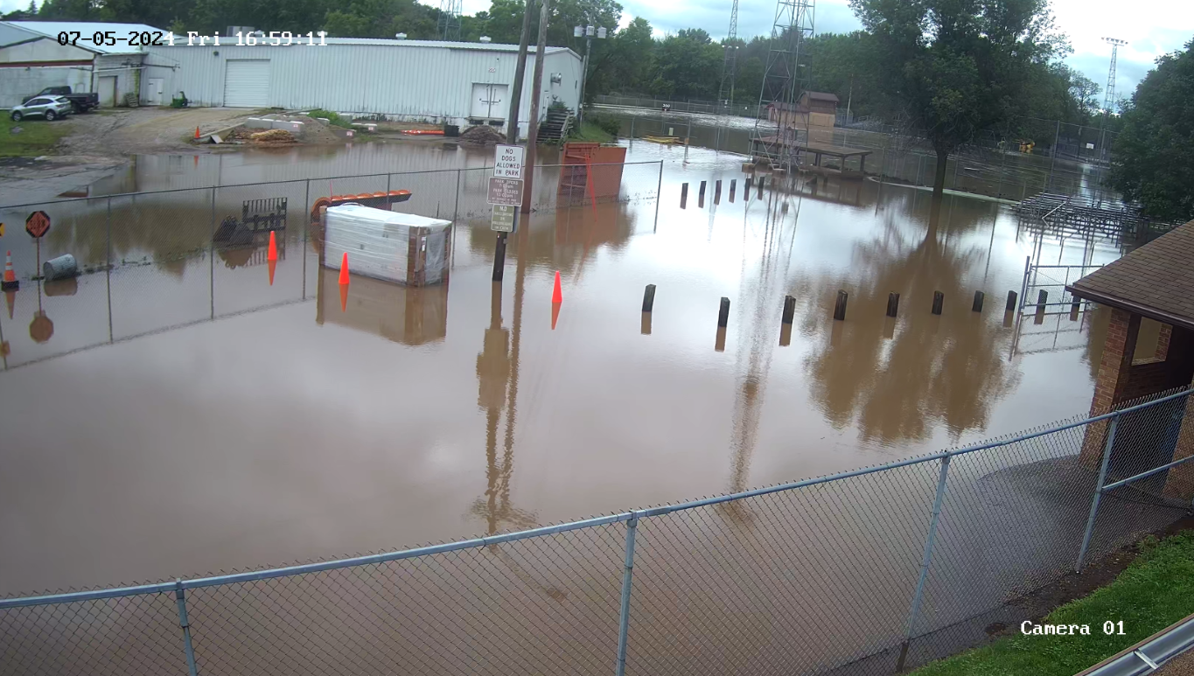

Slide 30
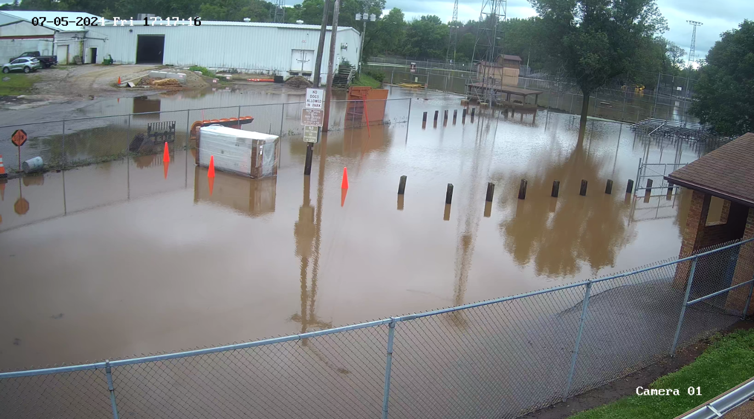

Slide 31
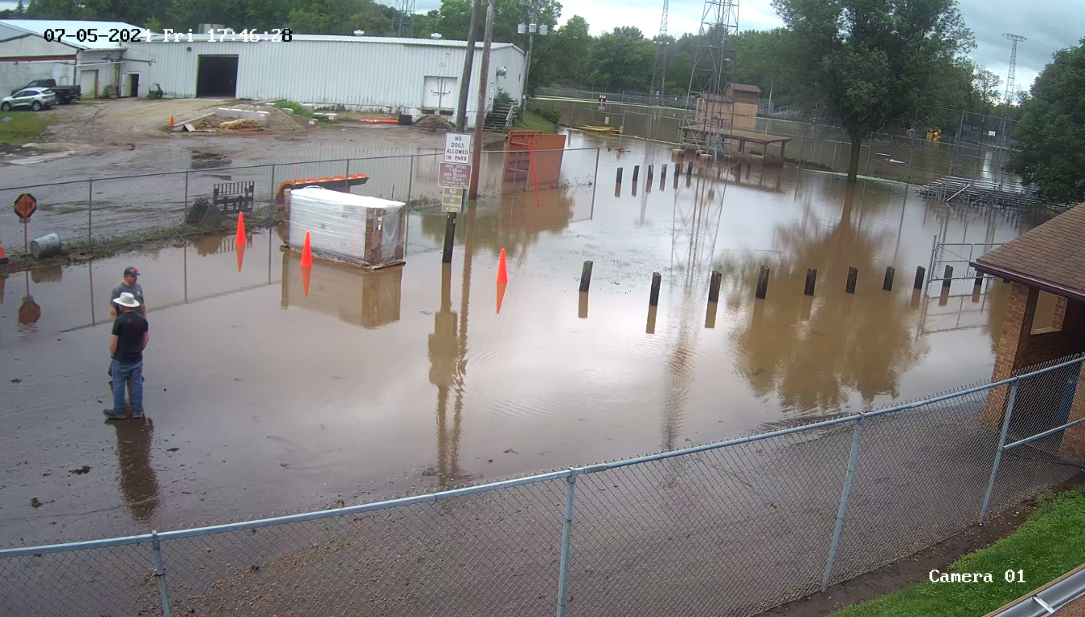

Slide 32
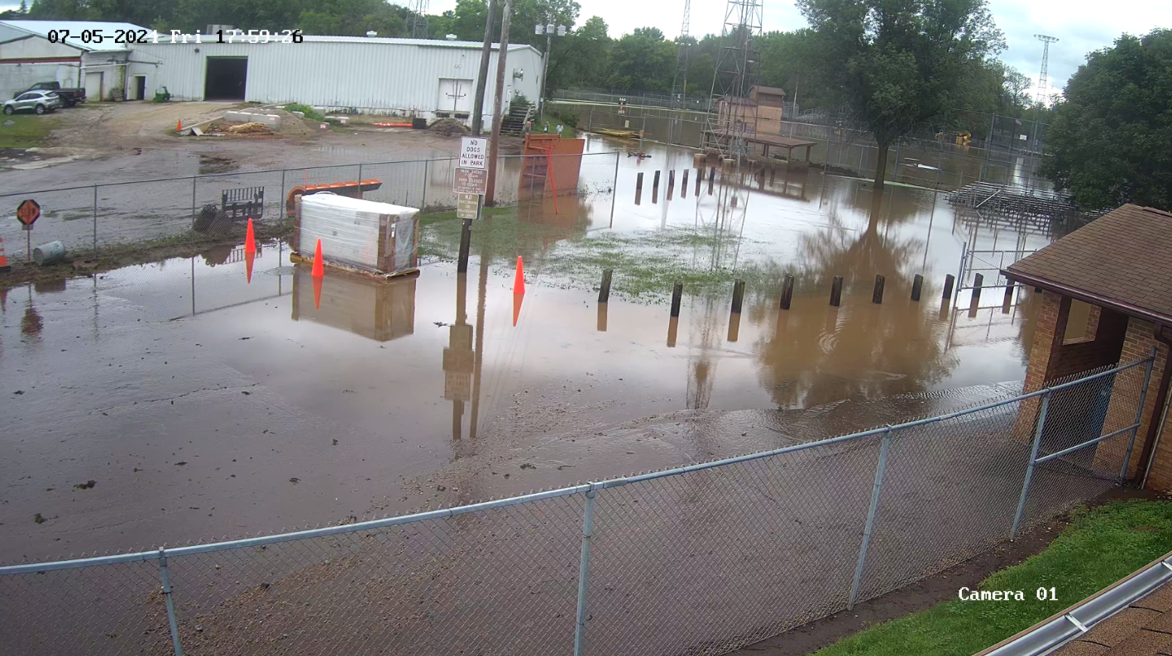

Slide 33
Steps following the Flash Flood
DOT inspected the Bridge and found it to be safe and it was opened at 5:00 pm and continued with follow-up inspections throughout the week
City issues water boil advisory and lifts it after a safe water test
Drinking water distributed to the public
Dam embankment was blocked off to pedestrians for safety. Sturm Memorial Library lot later closed for safety and trees removed near shoreline. Lot reopens.
County Highway Department barricaded damaged roads
Department of Public Works brought the wastewater treatment plant back on-line
Cedar Corp (city’s civil engineers) inspected the dam
DNR inspected affected areas
Saturday morning, City and county officials met for an initial inspection of the park
Monday, City and county officials met to discuss next steps towards recovery
City provides three days of dumpster for citizens to dispose of affected property
Gov Evers declares the flash flood a state of emergency

